Slide 1


Ordering numbers in standard form
Task A: Comparing numbers in standard form
1) Put the following in ascending order, smallest to largest.
a)
b)
c)
d)
3 × 10¹²
1 × 10¹³
4 × 10¹¹
2 × 10¹⁰
9 × 10⁹
9 × 10⁹
2 × 10¹⁰
4 × 10¹¹
3 × 10¹²
1 × 10¹³
2.3 × 10⁴
2.3 × 10⁻¹
2.3 × 10⁻⁴
2.3 × 10⁻³
2.3 × 10
2.3 × 10⁻⁴
2.3 × 10⁻³
2.3 × 10⁻¹
2.3 × 10
2.3 × 10⁴
4.99 × 10⁶
4 × 10⁶
9.8 × 10⁻⁷
4.99 × 10⁻⁶
4.9 × 10⁻⁶
9.8 × 10⁻⁷
4.9 × 10⁻⁶
4.99 × 10⁻⁶
4 × 10⁶
4.99 × 10⁶
9.7 × 10⁻²
1.001 × 10⁹
9.89 × 10⁻²
1.5 × 10⁻⁴
1.01 × 10⁹
1.5 × 10⁻⁴
9.7 × 10⁻²
9.89 × 10⁻²
1.001 × 10⁹
1.01 × 10⁹
2) Put the following in ascending order in the format they are given.
a)
1 × 10³
0.0089
0.1
8.2 × 10⁻⁴
90 000
1 × 10³
8.9 × 10⁻³
1 × 10⁻¹
8.2 × 10⁻⁴
9 × 10⁴
8.2 × 10⁻⁴
0.0089
0.1
1 × 10³
90 000
b)
21 000
0.000 087
0.0002
2.01 × 10⁴
0.000 078
2.1 × 10⁴
8.7 × 10⁻⁵
2 × 10⁻⁴
2.01 × 10⁴
7.8 × 10⁻⁵
0.000 078
0.000 087
0.0002
2.01 × 10⁴
21 000
3) Laura says
Explain why Laura has not correctly ordered the numbers.
I have put the following in ascending order by ordering the exponents first and where the exponents are the same, I have ordered the number.
Laura
0.6 × 10⁻¹
6 × 10²
6.2 × 10²
0.618 × 10³
To order according to the exponents and then the A number, all the numbers must be correctly written in standard form. Some of these numbers are not in standard form.

Slide 2
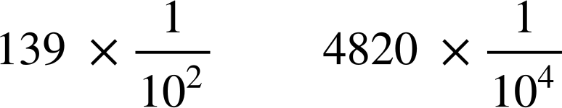
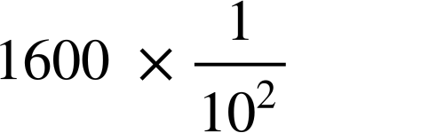
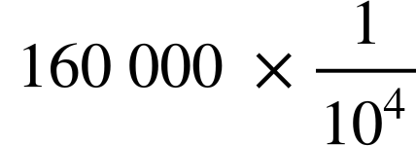
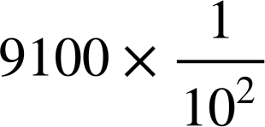
Ordering numbers in standard form
Task B: Ordering numbers using standard form
1) Using inequalities, <, > or =, compare the sizes if each number, making sure to show your working out.
a)
b)
c)
d)
>
3.8 × 10⁻¹ > 4.8 × 10⁻²
<
7.8 × 10 < 9.9 × 10³
>
1.39 × 10⁰ > 4.82 × 10⁻¹
=
1.6 × 10¹ = 1.6 × 10¹
2) By working out the number, write in standard form and order the original form given in the question.
a)
3.8 × 10⁻³
7.9 × 10⁻¹
7.8 × 10⁻²
8 × 10⁰
b)
9.2 × 10⁻²
9.21 × 10
9.8 × 10⁻¹
9.1 × 10
c)
4.8 × 10
4.8 × 10⁻²
4.81 × 10⁻²
4.82 × 10⁻¹
Mathematics in Education and Industry
v2.3

